Slide 1


Project Title:- Student Performance Analysis Team Name:- Data Insights Creator Team Leader Name:- Venkatesh Garg

Slide 2

Key Insights from Student Performance Analysis Dashboard
📊 KPI Overview
✅ Total Math Score: 66K — Indicates cumulative math performance across all students.
✅ Average Reading Score: 69.17 — Represents a decent average, suggesting overall reading proficiency.
✅ Total Writing Score: 68K — Suggests consistent performance in writing relative to math.
👩‍🏫 Performance by Gender
📌 Females outperformed males in Math Scores, showing a higher cumulative contribution.
🎓 Parental Level of Education
👩‍🎓 Majority of students have parents with:
Some college: 22.6%
Bachelor’s degree: 22.2%
High school: 19.6%
📉 Only 5.9% of students' parents have a Master’s degree.

Slide 3
More Insights
🌍 Performance by Race/Ethnicity
🧮 Group E shows the highest average scores across Math, Reading, and Writing.
📉 Group A and Group C exhibit comparatively lower performance.
📊 Race distribution:
🟦 Group A: 31.9%
🟨 Group B: 26.2%
🟩 Group C: 19.0%
🟧 Group D: 14.0%
🟥 Group E: 8.9%
🧪 Impact of Test Preparation
Students who completed the test preparation course:
📈 Achieved significantly higher scores in Math, Reading, and Writing.
Students with no prep show visibly lower academic scores.
🍽️ Lunch Type Insights
Majority of students are on standard lunch, indicating regular nutrition.
Students on free/reduced lunch may require additional academic or wellness support.

Slide 4
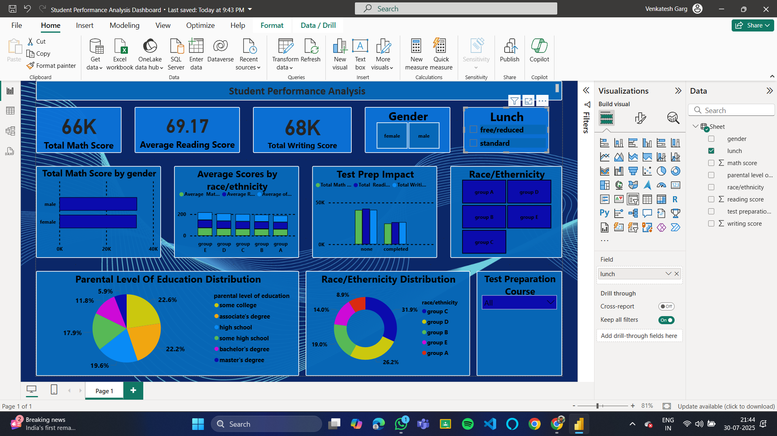
Conclusion:- The dashboard reveals a strong correlation between test preparation, parental education, and student performance. Ethnicity and gender also play a role in score distribution, highlighting areas where targeted support and intervention can be implemented to improve outcomes.

Slide 5


Thank You

